Slide 1

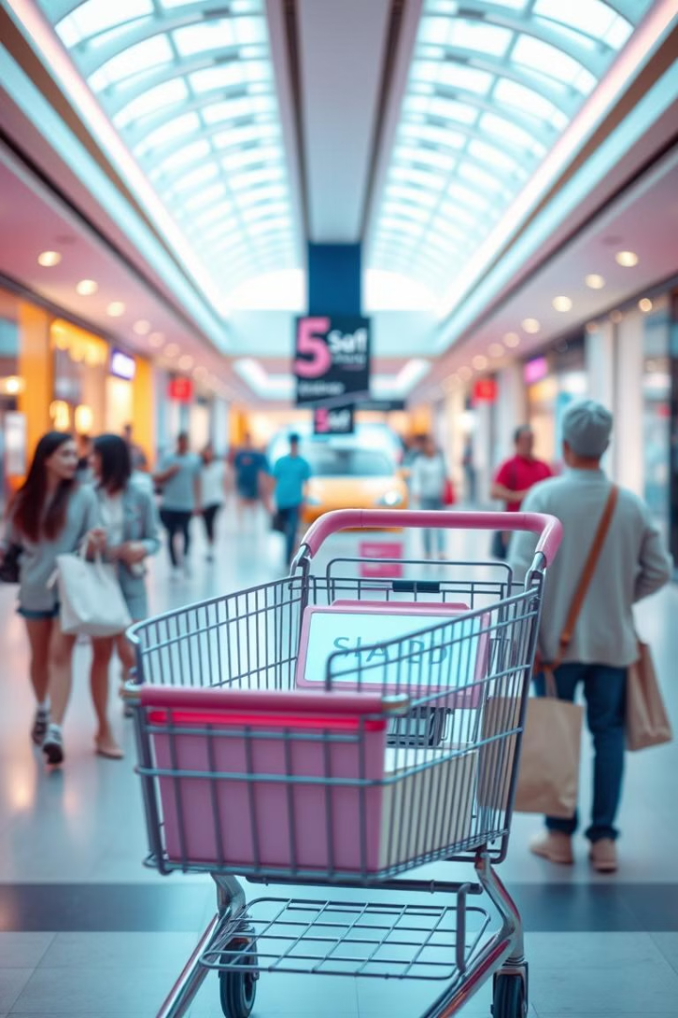

Smart Shopping Cart with RFID Technology
In today's fast-paced world, technology enhances customer experiences in shopping centers. This presentation introduces a smart shopping cart designed to streamline the shopping process, reduce wait times, and improve overall efficiency for both customers and store employees.
The smart cart uses RFID technology to automatically detect items, provide billing information, and communicate with a central server, offering a modern solution to traditional shopping challenges.

Slide 2
The Need for Smart Shopping Solutions
Rising Demand
Customer Satisfaction
Employee Workload
Shopping centers are essential, but overcrowding leads to long queues and reduced efficiency.
Shoppers want convenience and transparency in their spending to enhance satisfaction.
Skilled salespersons are needed for item arrangement, customer guidance, and billing.
The smart shopping cart addresses these issues by providing a better shopping experience, reducing wait times, and improving the management of shopping centers. It aims to make shopping more luxurious, accessible, and effective.

Slide 3





Smart Cart Components and Functionality
RFID Reader
Arduino Nano
Wi-Fi Module
LCD Panel
Detects items tagged with RFID for automatic identification.
Microcontroller-based data acquisition and control unit.
Sends billing information to a central server for record-keeping.
Displays product information and billing details to the customer.
The smart cart allows customers to add or remove items, view the final bill, and sends data to a central unit. This reduces shopping duration and avoids long queues at billing counters, enhancing the overall shopping experience.

Slide 4





How the Smart Shopping Cart Works
RFID Tag Scan
Customer places product near the scanning area.
Product Display
Product name and cost are displayed on the LCD screen.
Add/Remove
Customer uses buttons to add or remove items.
Final Billing
Total bill is generated and sent to the central unit.
The process begins with scanning the RFID tag attached to a product. The RFID reader detects the unique identity number and sends the information to the microcontroller. The product name and cost are displayed on the LCD screen, and customers can add or remove items using push buttons.

Slide 5




Benefits of the Smart Shopping Cart
Reduced Wait Times
Budget Management
Faster checkout process with automatic billing.
Customers are aware of the total bill amount during shopping.
User-Friendly
Convenient and flexible shopping experience with easy-to-use interface.
The smart shopping cart helps customers manage their budget, reduces shopping time, and enhances the overall shopping experience. It provides flexibility to add or remove items at any time before producing the final bill.

Slide 6
Testing and Analysis of the Smart Cart
Accurate Detection
Unique Identification
Error Handling
The model accurately detects items within a second without delay.
Each RFID tag has a 32-bit unique identity number.
The LCD displays 'Not in Menu' if the item is not in the crosscheck list.
The hardware module was tested for multiple items repetitively and randomly, producing accurate detection each time. The system can detect thousands of items efficiently without false detection, ensuring a reliable shopping experience.

Slide 7
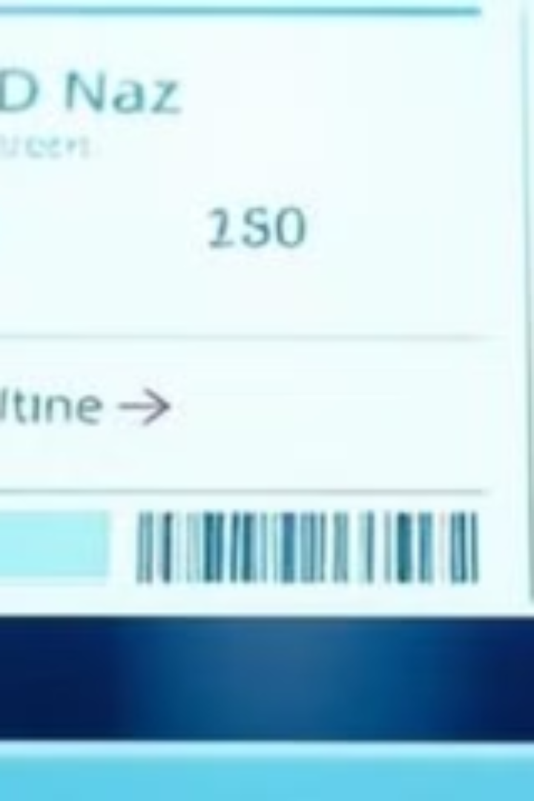




Smart Cart Components and Functionality
RFID Reader
Arduino Nano
Wi-Fi Module
Detects items tagged with RFID.
Sends billing information.
Microcontroller-based unit.
Automatic identification.
To a central server.
Data acquisition and control.
LCD Panel
Displays product information.
Billing details.
The smart cart allows customers to add or remove items and view the final bill.

Slide 8
Conclusion and Future Enhancements
Enhanced Shopping
1
Improves customer experience and reduces shopping time.
Efficient Management
2
Reduces workload on shopping center employees.
Scalability
3
Can be expanded to include thousands of items in the database.
The smart shopping trolley enhances the shopping experience, reduces shopping time, and improves budget management. Future enhancements include expanding the database to accommodate thousands of items, making it suitable for large shopping malls.

